Slide 1


When you send a message to someone online, where does it actually go?
Draw a diagram or jot some ideas down on your whiteboard

Slide 2

Recap
What is a mac address?
What is a ip address?
What does LAN stand for?
What does WAN stand for?

Slide 3
Recap
Draw a star network
Draw a mesh network
Draw a tree network
What does a VLAN do?

Slide 4

Learning Objectives
Identify key components of a network and what they do
Apply understanding to diagnose and explain network faults
Explain how OSI and TCP/IP models describes how data moves through a network
Match and interpret common network protocols

Slide 5

What do you think happens between typing a web address and the page loading?

Slide 6


Slide 7


Client
The device that asks for something
Notes:
The client device initiates communication
Like a customer ordering food in a restaurant

Slide 8

Server
The device that provides what’s been requested
Notes:
The server stores data, apps and services
The waiter/kitchen providing what the customer asked for

Slide 9
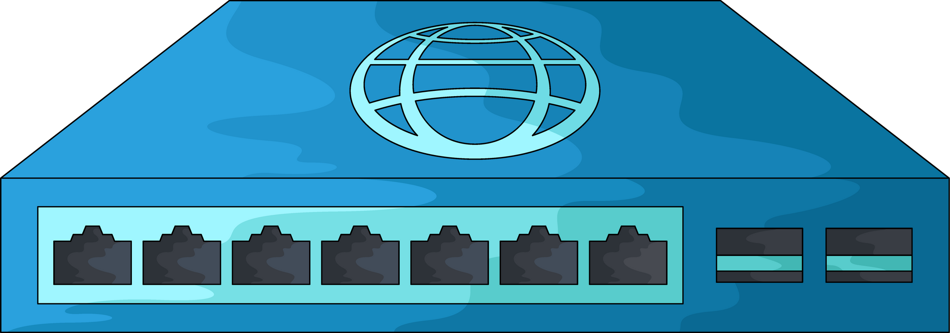
Switch
Connects multiple devices in a LAN and directs traffic inside that local network
Notes:
Like a post office sorting mail to the right person inside of your building

Slide 10
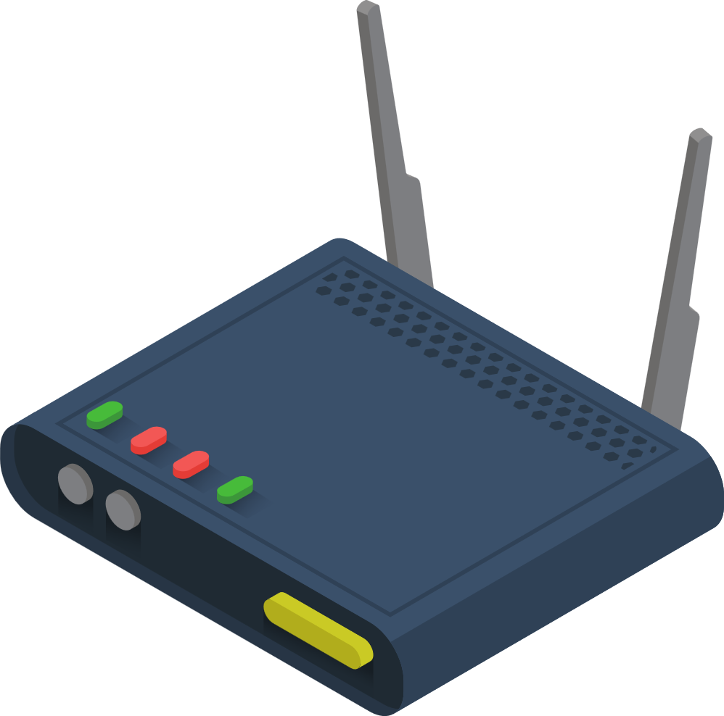
Router
Connects different networks
Notes:
Directs traffic between LANs and the internet using an IP address
Like a traffic controller or a motorway junction deciding each road each packet should take

Slide 11

Internet/Backbone
Global system or routers and high speed fibre links managed by internet service providers
Notes:
Like the motorway system connecting cities. The internet backbone is like a big motorway like the M4 or M6
This is where your data travels at light speed

Slide 12
Draw a diagram of a small office network
You need to include a client, switch, router, server, and internet
Write a sentence on each element and explain what it does
Notes:
Instructions:
“Use the cards/worksheet (or diagram) to create a small office network.
Include: Client, Switch, Router, Server, Internet.
Then write one sentence about what each does.”
💬 Stretch: Add a printer and explain where it fits.
💬 Check-back: “Which connects your LAN to the internet?

Slide 13
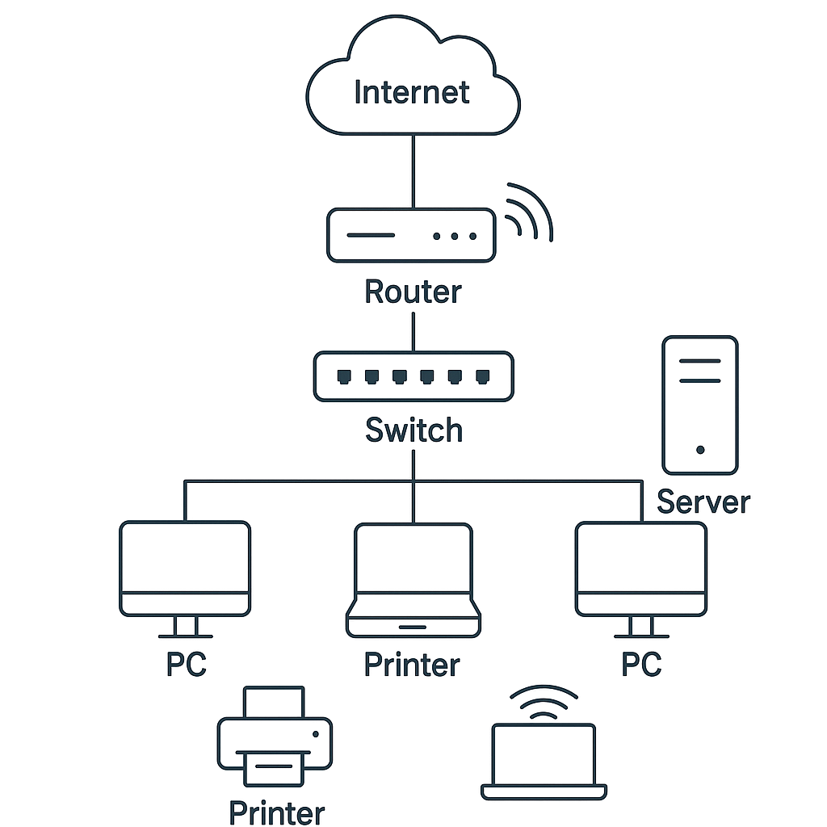
Network detective
PC 1 - internet works, no server access
All lights on the switch are on
The router is online
PC 2 - nothing works
1
2
Notes:
Which devices would you check and why?
The server is offline, misconfigured, or disconnected from the switch.
A cable or port between server and switch failed.
Firewall on server is blocking local connections.
DNS issue — client can resolve external addresses but not local server name.

Slide 14
When you send a message online, it doesn’t just go straight from one device to another
It’s wrapped and unwrapped in layers, like parcels

Slide 15

Each layer adds instructions
Notes:
Format - address, delivery route, physical transfer

Slide 16

The OSI and TCP/IP models explain how each step happens

Slide 17
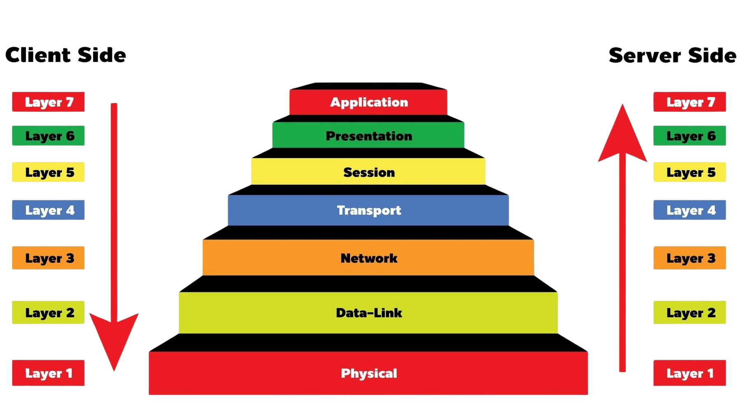
Notes:
Each layer has a job
Data moves down the layers when sending, and up the layers when receiving

Slide 18

Come up with your own pneumonic to help you remember the different steps of the OSI layer model
Notes:
Each layer has a job
Data moves down the layers when sending, and up the layers when receiving

Slide 19
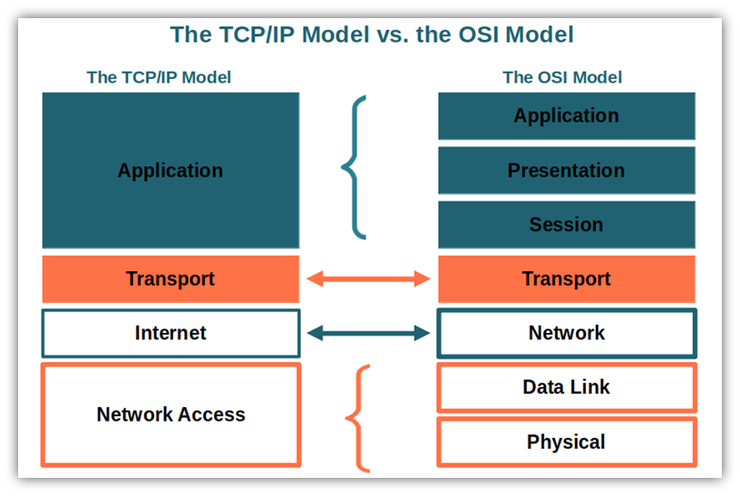
Notes:
The TCP/IP model is what we actually use today
It combines some OSI layers
Simpler - OSI is an academic reference moel
TCP/IP is a real world practical stack
Both are helpful for assisting engineers in diagnosing issues and designing networks

Slide 20

What might happen if a layer fails?

Slide 21
Match each type of tool to its layer
Router
Switch (Dumb and managed)
Web browser
Cable
Notes:
Stretch: Which OSI layers do the router and switch operate at, and why?

Slide 22
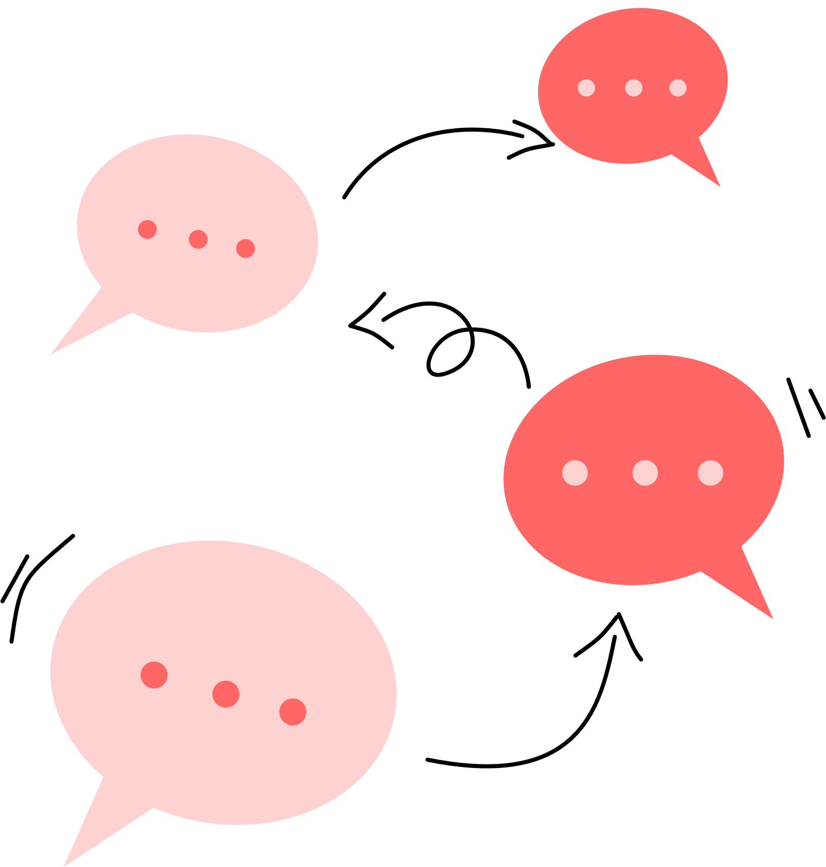
Protocols
Notes:
Which devices would you check and why?
The server is offline, misconfigured, or disconnected from the switch.
A cable or port between server and switch failed.
Firewall on server is blocking local connections.
DNS issue — client can resolve external addresses but not local server name.

Slide 23
Protocols
Every time we use the internet, hundreds of tiny ‘languages’ (protocols) work together to move data.
You’re going to become protocol experts and teach the class one of them
Notes:
Stretch: Which OSI layers do the router and switch operate at, and why?
A HTTP / HTTPS
B SMTP Mail
C POP3 or IMAP
D FTP / SFTP
E DNS
F DHCP
G RIP / OSPF

Slide 24

Protocols
What does it stand for?
What does it do?
Which OSI/TCP layer does it belong to?
A real-world example of it in action
Notes:
Compare it with another similar protocol (e.g., HTTP vs HTTPS).
Explain what could go wrong if it failed (e.g., “If DNS went down…”).

Slide 25

Teach Back
What does it stand for?
What does it do?
Which OSI/TCP layer does it belong to?
A real-world example of it in action
Notes:
Compare it with another similar protocol (e.g., HTTP vs HTTPS).
Explain what could go wrong if it failed (e.g., “If DNS went down…”).

Slide 26
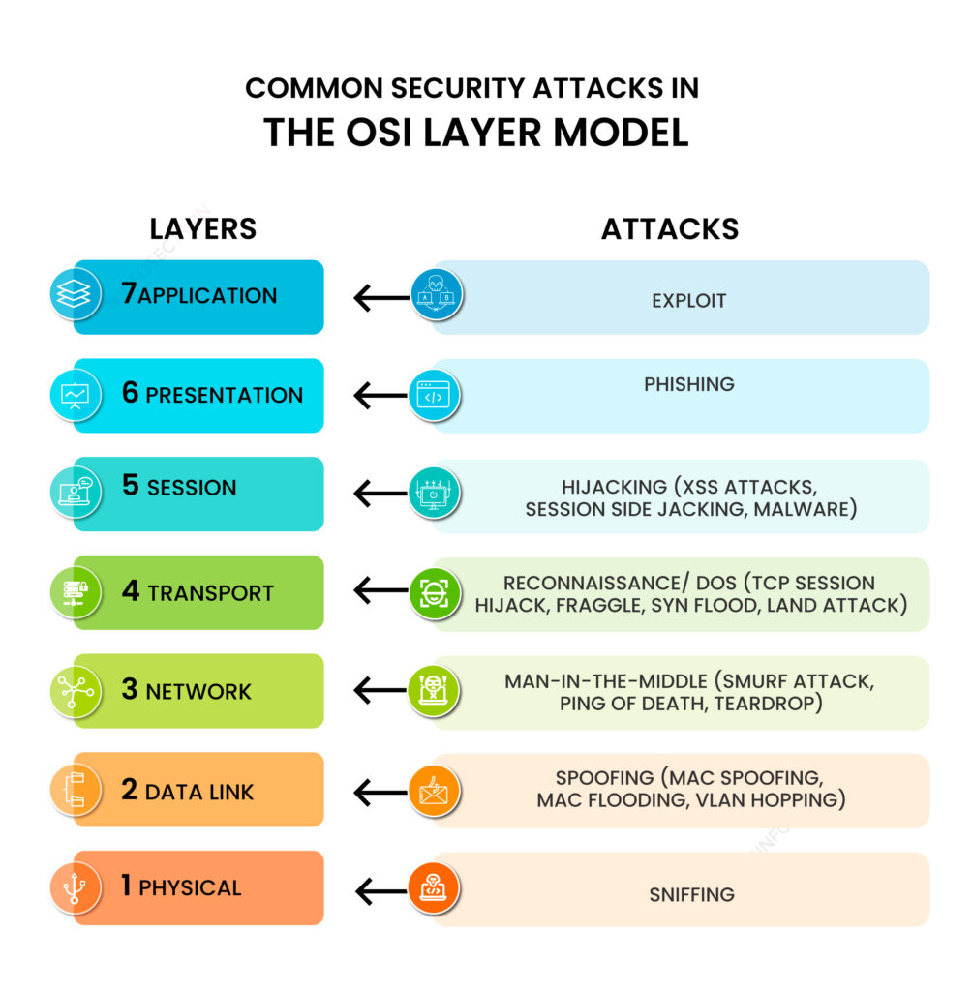
Notes:
Compare it with another similar protocol (e.g., HTTP vs HTTPS).
Explain what could go wrong if it failed (e.g., “If DNS went down…”).

Slide 27

Which of these protocols do you think we use the most often?
Notes:
Compare it with another similar protocol (e.g., HTTP vs HTTPS).
Explain what could go wrong if it failed (e.g., “If DNS went down…”).

Slide 28

What would happen if DNS or DHCP failed?
Notes:
Compare it with another similar protocol (e.g., HTTP vs HTTPS).
Explain what could go wrong if it failed (e.g., “If DNS went down…”).

Slide 29

Recap
Which device connects networks?
Which layer adds addressing Info
What protocol gives IP addresses
What does HTTPS do differently to HTTP?
What OSI layer would a switch operate at?
Notes:
https://www.educaplay.com/learning-resources/4104685-osi_model.html

Slide 30
Learning Objectives
Identify key components of a network and what they do
Apply understanding to diagnose and explain network faults
Explain how OSI and TCP/IP models describes how data moves through a network
Match and interpret common network protocols

Slide 31
Extension
Imagine you are journalists for Tech Weekly, and you’ve just heard that one major internet protocol has suddenly failed across the world.
Your job is to create a quick news flash (short article or poster) explaining:
Which protocol failed (choose one: DNS, HTTP, SMTP, DHCP, etc).
What that protocol normally does
What’s happening to people/businesses now that it’s broken
(Stretch) Which OSI/TCP layer it belongs to and how engineers might fix it.

Slide 32

Which failure would cause the most chaos?

Slide 33

If you could only keep 3 network protocols, what would they be and why?

